Slide 1
26TH DIGITAL BLUE ECONOMY SUMMIT
ParaSail
A smart guide for safer fishing and healthier oceans
Predictive Advisory and Retrieval-Augmented System Advancing Informed Livelihoods
Is it safe to sail?
Are the fish there?
Is it allowed?
One simple answer to all three questions - before you leave the harbour.
Anantha Krishnan AS · Naipunnya School of Management, Cherthala, India · September 2026
Notes:
Open with the three questions every fisher asks before sailing. ParaSail answers all three in one place, in plain language. The deck is interactive: the next slide is a contents hub - every card jumps to its section, and the ☰ CONTENTS link returns here from any slide.

Slide 2
CONTENTS
What we will cover
1
The problem
2
The answer
Why fishers and the ocean both need better information
One clear answer: GO, GO CAREFULLY, WAIT OR MOVE, STOP
3
What you see
4
The honest map
The answer in plain words - with its reasons listed
Where the fish likely are - and where you must not go
5
Ask the AI
6
The evidence
A local AI helper that cites its sources
What we tested - and what it proved
7
Who wins
8
Conclusion
Fishers, the ocean, communities, authorities
One simple idea, and what comes next
Tap any card to jump straight to that part of the story.
Notes:
Interactive contents: each card is a hyperlink to its slide. Use it to jump around during Q&A instead of paging through.

Slide 3
THE PROBLEM
☰ CONTENTS
Why fishing needs help
1 in 3
3× more
500 million
fish populations are now overfished
plastic flowing into the ocean by 2040
people depend on small-scale fishing
FAO, 2023
UNEP, 2023
FAO, 2023
Fish are moving
Spawning is disturbed
The sea is dangerous
Rules are hard to check
Warming seas push fish to new waters, and the old seasonal calendars drift out of step.
Fishing while fish breed leaves fewer fish for everyone next year.
District-wide forecasts say nothing about the wind and waves off your own ground.
Boundaries and closed seasons live in offices and on paper - not at sea.
Sources: FAO State of World Fisheries 2023; UNEP Turning off the Tap 2023; Cheung et al. 2010.
03
Notes:
Frame it in one slide: a third of stocks overfished, plastic tripling, half a billion livelihoods - and four daily problems: fish move, spawning is disturbed, the sea is dangerous, and the rules are hard to check at sea. Everything that follows answers these four.

Slide 4
THE SOLUTION
☰ CONTENTS
Meet ParaSail - one clear answer
Click to reveal each signal
Like a weather app - but for fishing.
GO
Calm seas, fish likely, zone open - safe to sail.
You tell it where you will fish, what you are catching and when. Before you leave the harbour it gives you one simple answer - and the reasons behind it.
GO CAREFULLY
Fishing is possible - but watch the changing weather.
WAIT OR MOVE
Rough seas or young fish nearby - wait, or try another spot.
Free · in your language · installs like a phone app
STOP
Not safe, or not allowed. Stay ashore today.
Protected area or closed season? The answer is always STOP - whatever the weather.
04
Notes:
The four answers are a traffic light everyone already understands. Reveal them one at a time - ask the room to guess the colour for 'rough seas with young fish nearby'. The hard rule: protected areas and closed seasons are always STOP.

Slide 5
THE SOLUTION · THE ANSWER
☰ CONTENTS
What you actually see
TOMORROW, 5 AM — OFF KOCHI
WHILE IT THINKS
GO
Reading the sea…
A live progress cue - animated wave bars - so you always know it is working.
PLAIN-LANGUAGE EXPLANATION
GO — calm seas.
Nothing is invented. If the data cannot support a claim, the system says so instead of guessing - and the full detail stays one tap away.
Sea right now: wind 12 km/h, waves 0.8 m, currents 1.2 km/h.
Indian oil sardine likely in this area.
Simple on purpose. A fishers' eye view first; the numbers live behind it for anyone who wants them.
Risk to young fish and habitats: low.
Every point is a separate reason you can check - not a wall of text.
05
Notes:
This is the change fishers asked for: instead of a paragraph, the explanation now arrives as separate, checkable points - verdict, conditions, fish likelihood, ecological risk. And while it works, an animated cue shows progress.

Slide 6
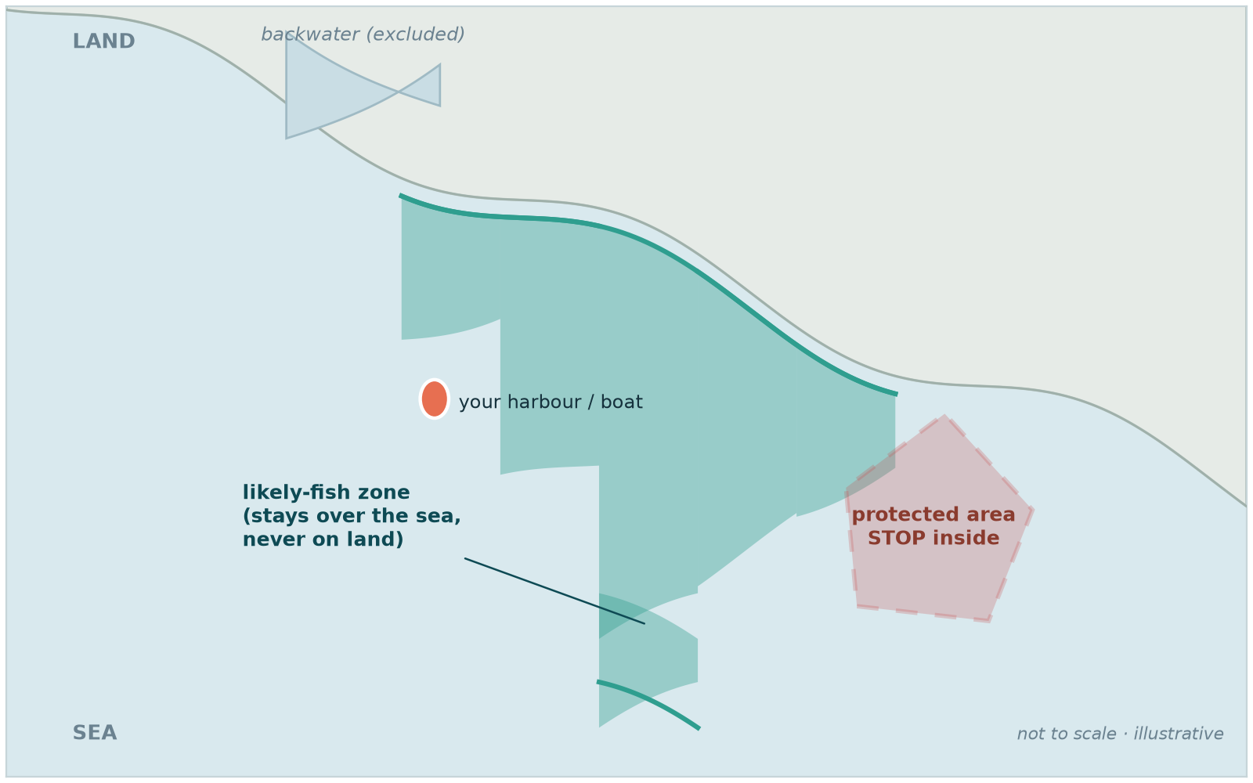
THE SOLUTION · THE MAP
☰ CONTENTS
The map shows where - honestly
1
Follows the real coastline
The likely-fish area is drawn from actual shoreline geometry - it never spills over land or into backwaters.
2
Protected areas, for real
Real marine-park boundaries. Inside one the answer is STOP - and it names the park you are in.
3
Honest when nothing fits
If conditions do not suit the fish, it shows a small honest zone - or none - instead of inventing one.
Illustrative view of the coast, the likely-fish zone and a protected area.
A fishing zone that covers a town, or a 'protected area' you cannot see, protects nothing. The map is built so a fisher can trust it.
Zone geometry: GSHHG shoreline data (public domain) · Park outlines: OpenStreetMap contributors (ODbL).
06
Notes:
Two honesty guarantees on one slide. The likely-fish zone is clipped to real shoreline geometry - no lakes, no land. Protected areas use real boundaries, and if you are inside one the answer is STOP with the park named.

Slide 7
THE SOLUTION · THE AI HELPER
☰ CONTENTS
Ask it anything - in your own words
ASK PARASAIL
1
Answers in plain words
Ask like you would ask a neighbour - and it replies in your own language.
“Can I take my small boat out tomorrow?”
GO CAREFULLY - waves near 1 m in the morning, wind rising after noon. Best back before two.
sources: marine forecast · rulebook
2
Shows its sources
Every answer points to the forecast, rule or local knowledge it used.
“And in June, for sardine?”
3
Honest about the hardware
It never pretends a model is running when it is not.
AI: qwen2.5vl-3b-laptop · READY
It checks what is actually installed on this computer and says so - and if a model is missing, it prints the exact command to get it.
The AI explains the advice - it never overrules it. Closed season? Still STOP.
07
Notes:
The AI helper answers in the fisher's own words and language, cites sources, and is honest about what hardware it is actually running on - if the model is missing it says so and prints the install command instead of pretending. It explains the advisory; it can never override it.

Slide 8
THE EVIDENCE
☰ CONTENTS
It worked - here is what we found
✓
Live data kept flowing
Even when the internet dropped, advice continued - clearly marked as slightly older information.
✓
Closed seasons were always respected
Every single test during a closure came back STOP. No exceptions, ever.
✓
Advice changed sensibly
When the weather turned or the fish moved, the traffic light changed exactly as it should.
✓
Every answer explained itself
The reasons shown next to each advice were checked - and they were the right ones.
✓
The map stayed over water
Likely-fish zones followed the coast and never covered land, lakes or backwaters.
✓
The AI never overruled the verdict
It explains, cites and defers - the decision stays with the rules, not the model.
08
Notes:
Six findings in plain terms: reliable data even offline, closures always respected, sensible changes with conditions, correct explanations, zones that stay at sea, and an AI that explains without overruling.

Slide 9
THE IMPACT
☰ CONTENTS
Everyone on the coast wins
Fishers
The ocean
Communities
Authorities
Save fuel, stay safer, and avoid fines from honest mistakes.
Protected zones and spawning seasons are left in peace - automatically.
Generations of fishing knowledge kept in a lasting digital library.
Clear, fair decisions backed by evidence anyone can see.
Made for your coast
Quick to set up for a new coast · runs on an ordinary computer · installs like a phone app on the boat · answers in your language, local fish names included
Next: a season-long trial with fishing communities, and voice guidance for hands-free use at sea.
09
Notes:
Four winners - fishers, the ocean, communities, authorities - and one system. Close the loop with what is next: a season-long community trial and voice guidance.

Slide 10
ONE SIMPLE IDEA
☰ CONTENTS
Fish smarter. Stay safe.
Keep the ocean giving.
ParaSail answers three questions every fisher already asks - is it safe, are the fish there, is it allowed - and shows its reasons every single time.
The phone app is here today - installed from the website, it works offline and speaks your language. Next: a season-long trial with fishing communities, and voice guidance.
Aligned with the UN Sustainable Development Goals: 14 Life Below Water · 2 Zero Hunger · 8 Decent Work · 9 Innovation · 13 Climate Action
Thank you
Anantha Krishnan AS · Naipunnya School of Management, Cherthala, India · 26th Digital Blue Economy Summit
10
Notes:
Close with the promise: fish smarter, stay safe, keep the ocean giving - then thank the audience and invite questions. The ☰ CONTENTS link returns to the hub for jumping back into any section.

